Slide 1

Real-Time Weather Streaming Pipeline
AWS + Kinesis + S3 + Databricks + Delta Lake
An end-to-end real-time ETL solution with a multi-layer Delta architecture for live weather data.Author:- Rajdeep Sanjay Parbhane

Slide 2
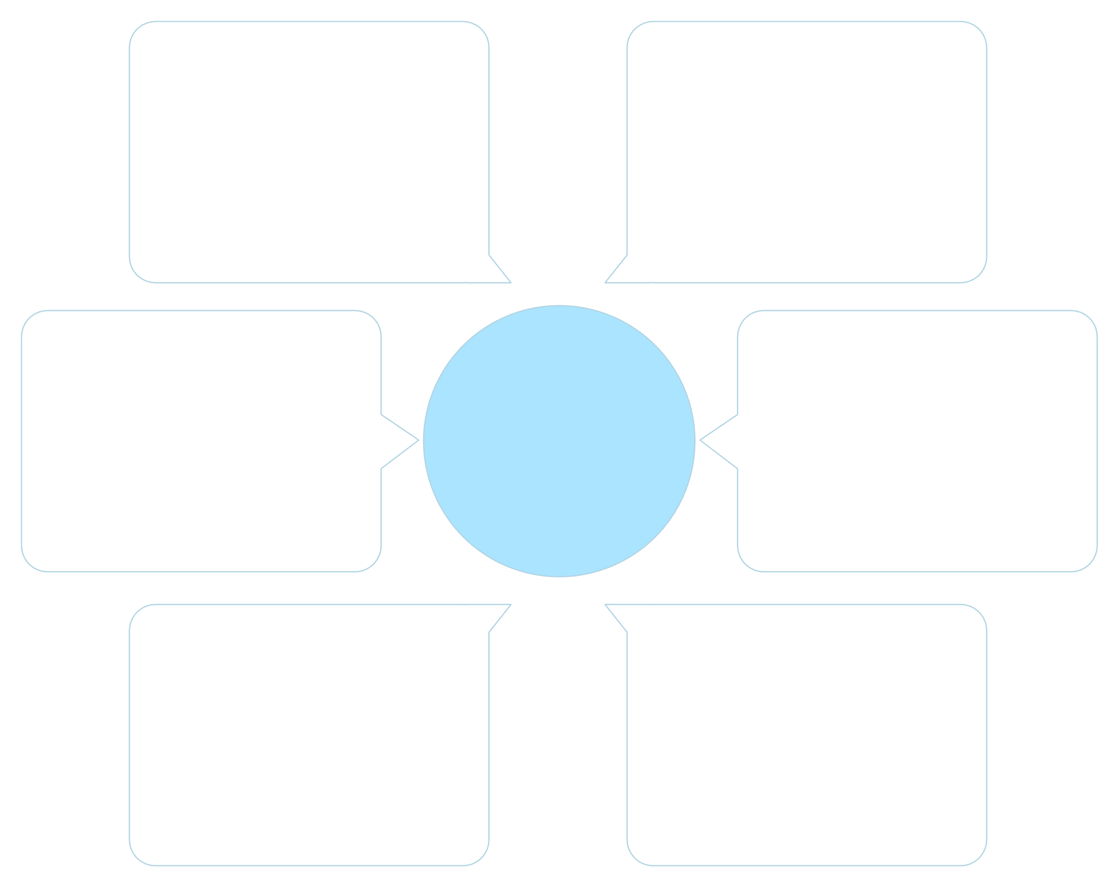
High-Level Architecture Overview
This pipeline demonstrates real-time data ingestion, processing, and storage using key AWS services and Databricks.
Databricks Silver
EC2 Weather Producer
Cleaned and enriched data
Generates telemetry and events
Kinesis Data Streams
Databricks Bronze
Real-time Weather Pipeline
Ingests streaming records
Raw delta ingestion
S3 Raw Bucket
Kinesis Firehose
Durable landing zone
Buffers and transforms data

Slide 3
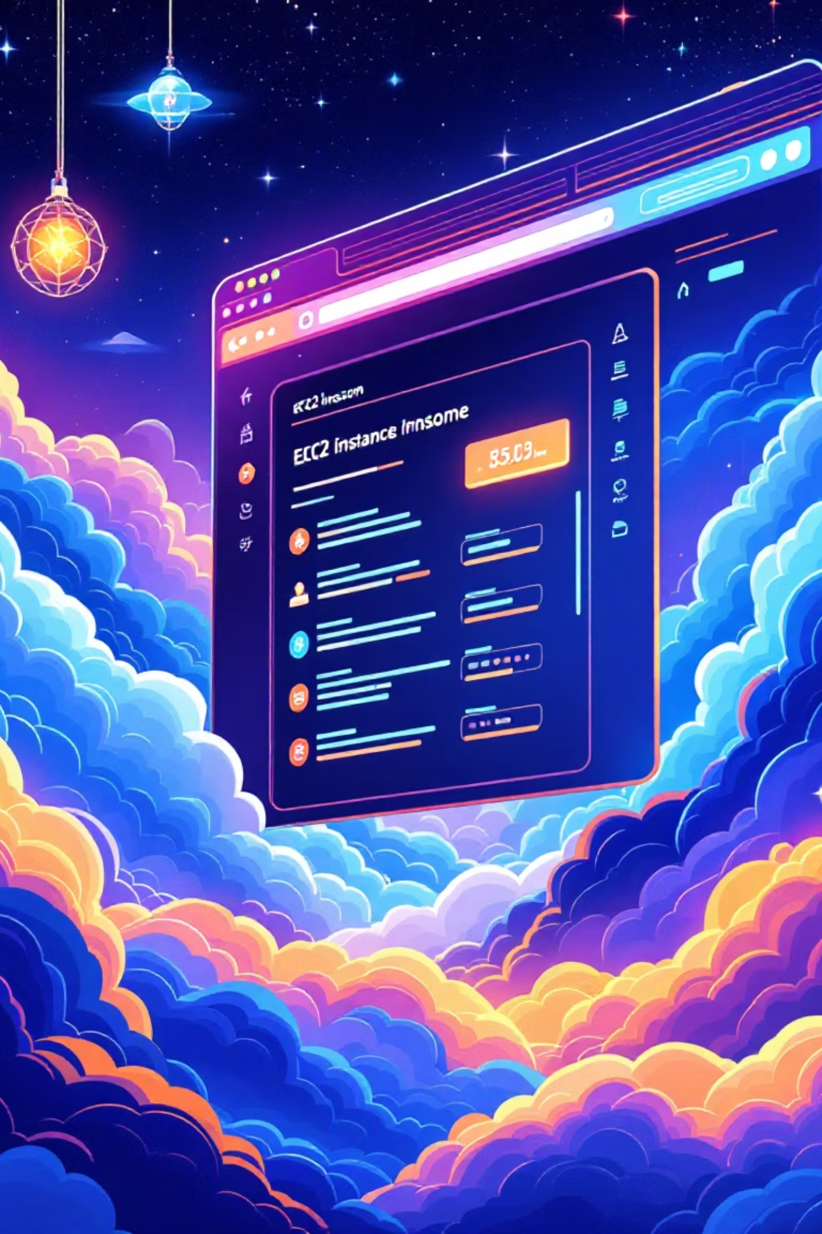

EC2 Setup: The Weather Data Producer
Why EC2?
Launch Configuration
Hosts a Python script generating live weather data every second, simulating real-time IoT sensor output.
Utilizes a t3.micro instance (free-tier eligible) with Ubuntu Server 22.04 LTS and 8GB gp2 storage.
Security & Access
Security group allows SSH (Port 22) and outbound traffic to AWS Kinesis endpoints.
Access via SSH using WSL Ubuntu terminal, with alternative options like PuTTY or EC2 Instance Connect.

Slide 4
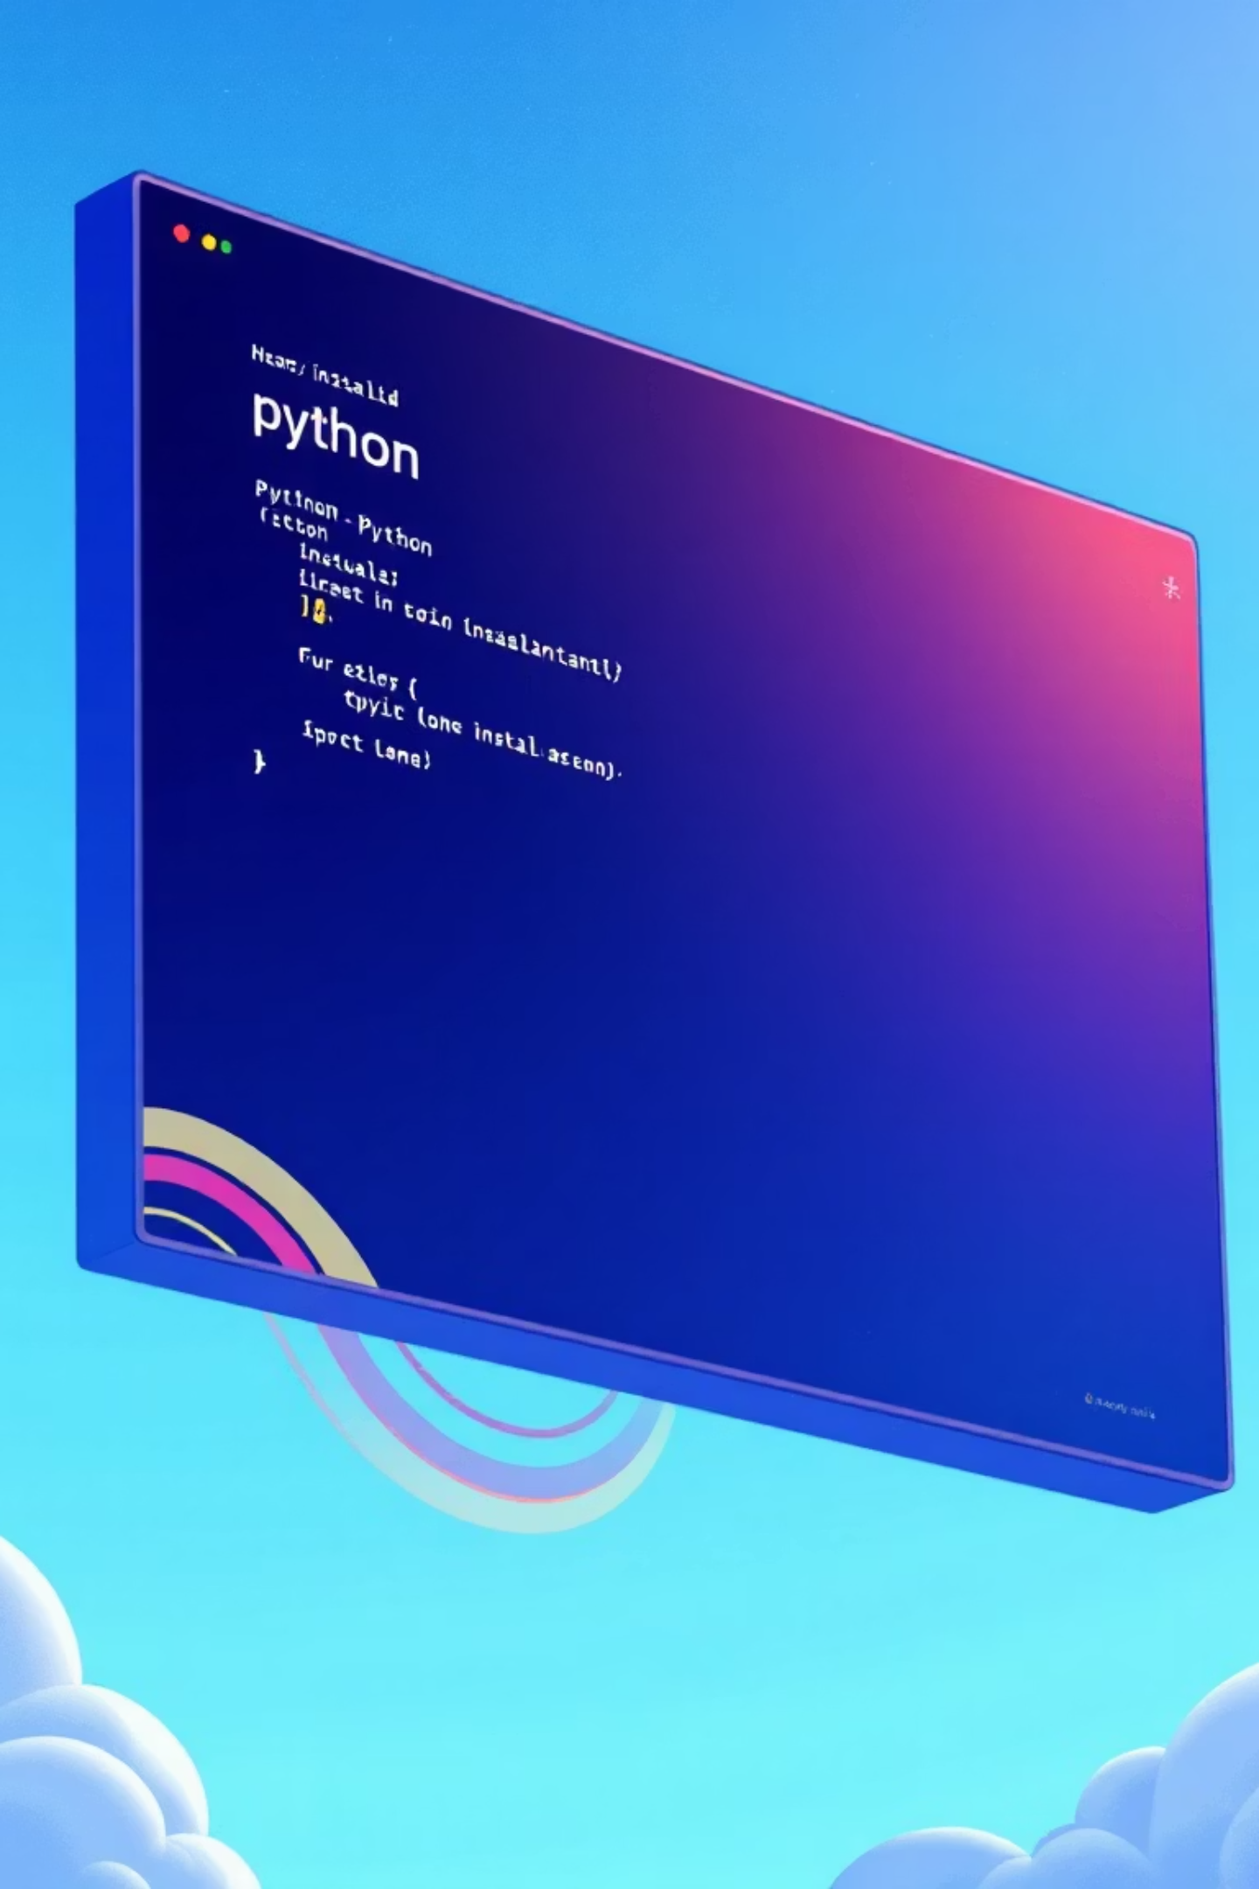
Setting Up the EC2 Environment
Essential dependencies are installed to enable data generation and secure communication with AWS services.
01
Update System
sudo apt update && sudo apt upgrade -y ensures all packages are current.
02
Install Python & Pip
sudo apt install python3 python3-pip -y for scripting and package management.
03
Install AWS SDK
pip3 install boto3 to programmatically interact with AWS services like Kinesis.
04
Export AWS Credentials
Configuring ~/.aws/credentials or environment variables for secure Kinesis access.

Slide 5

The Weather Producer Script
Script Functionality
Generates random weather metrics (temperature, humidity, pressure).
Packages data into JSON format.
Sends data to Kinesis Data Streams every second.
Why 1-Second Interval?
Accurately simulates real-time IoT sensor data streams.
Ensures a consistent data flow, optimizing Kinesis Firehose batching.
To execute, simply run: python3 producer_kinesis.py

Slide 6


Kinesis Data Stream Setup
The core of our real-time ingestion, configured for scalability and efficiency.
1
2
3
Stream Name & Capacity
Understanding Shards
On-Demand vs. Provisioned
weather-stream with On-Demand capacity mode for automatic scaling.
Each shard handles 1MB/sec write, 2MB/sec read, and 1000 records/sec, scaling transparently.
On-Demand eliminates manual shard management, making it cost-effective for fluctuating workloads.

Slide 7
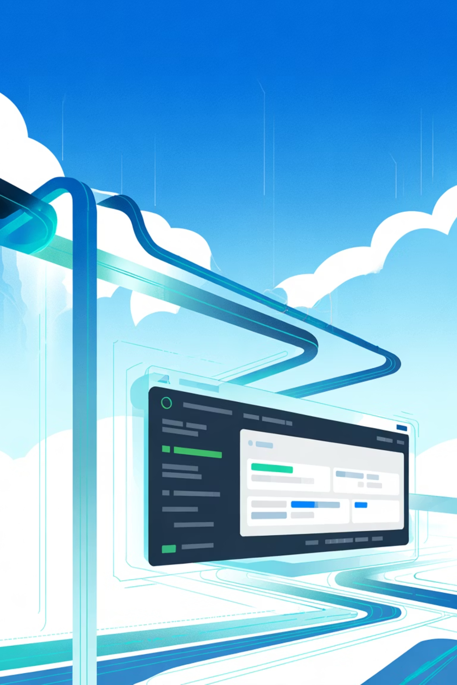
Kinesis Firehose Configuration
Reliable and cost-effective delivery of streaming data to S3, with optimized settings.
Delivery Stream Details
Optimization & Organization
Type: Direct PUT from Kinesis Data Stream to S3.
S3 Prefixing: kinesis/weather/ for data, kinesis/error/ for failed records. Enhances organization and downstream processing.
Source: weather-stream-ap-south-1.
Destination: S3 Bucket weather-stream-raw-ap-south-1.
Compression: Enabled (.gz) to minimize storage costs.
Buffering: 1 MiB or 60 seconds (whichever comes first).
Encryption: SSE-S3 default for data security at rest.

Slide 8

S3 Raw Data Lake Structure
Firehose automatically organizes incoming data into an efficient, partition-optimized folder structure.
s3://weather-stream-raw-ap-south-1/kinesis/weather/ └── 2025/ └── 12/ └── 07/ ├── 08/ file.gz ├── 09/ file.gz ├── 10/ file.gz └── 12/ file.gz
Why Hourly Folders?
Delivery Timestamp: Firehose groups files based on their delivery timestamp, facilitating chronological access.
Partition Pruning: Optimizes query performance by allowing Spark to read only relevant data partitions.

Slide 9

Databricks Cluster & Access
Configuring the compute environment for efficient Delta Lake operations.
Runtime Environment
Node Type & Scaling
IAM Role Challenges
Leveraging Databricks Runtime 16.4 LTS (Scala 2.12, Spark 3.5.2) for robust data processing.
Single m5d.large instance (8GB RAM, 2 vCPU) with autoscaling disabled for cost control.
Due to workspace restrictions, direct IAM role attachment was not feasible. Access Keys were used.
Access keys were configured via Spark: spark._jsc.hadoopConfiguration().set("fs.s3a.access.key", "...")

Slide 10
Bronze Layer: Raw Data Ingestion
The foundation of our Delta Lake, capturing raw data with minimal processing.
Minimal Cleaning
Read Raw S3 Data
Schema enforcement and addition of an ingestion timestamp for traceability.
raw_df = spark.read.option("recursiveFileLookup", "true").json(raw_path) to ingest all JSON files from S3.
Create Delta Table
Write to Bronze Delta
CREATE TABLE IF NOT EXISTS weather_bronze USING DELTA LOCATION 's3a://.../bronze/weather_readings' for structured access.
bronze_df.write.format("delta").mode("overwrite").save(bronze_path) to store data in Delta format.

